Slide 1
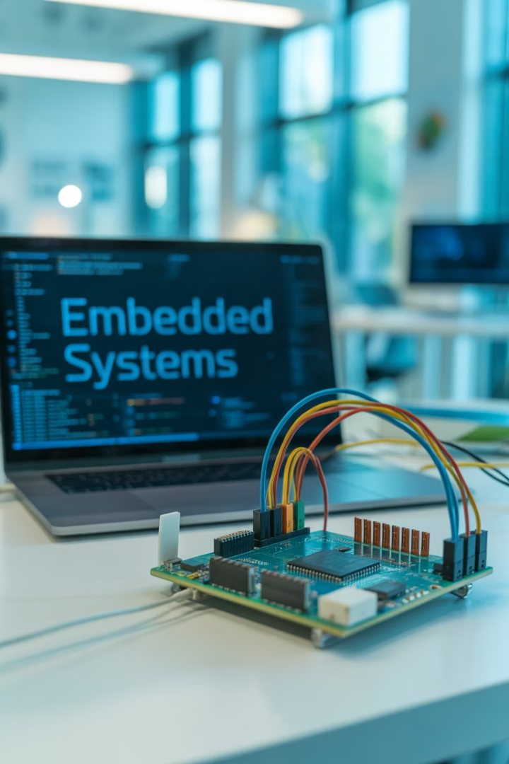
Zephyr RTOS Intro

Slide 2

Agenda
1
What is Zephyr RTOS?
Small, scalable open-source RTOS
2
Key Features
Architecture, boards, connectivity
3
Advantages
Compared to alternatives
4
Real-World Use
Products, trends, getting started

Slide 3

What is Zephyr RTOS?
Small & Scalable
Designed for resource-constrained embedded systems
Open Source
Vendor-neutral, community-driven
Wide Support
ARM, RISC-V, x86, Xtensa
Heritage
Originated from Wind River's Rocket OS (2015)

Slide 4
Key Features
Minimal Footprint
Extensive Support
<8KB Flash, <5KB RAM
750+ boards, 220+ sensors
Scalable to multi-core
CMake, Kconfig, Devicetree
BLE 5.3, Wi-Fi, CAN, USB
Full protocol support
Power management

Slide 5










Architecture Overview
Application
User code
Services
Middleware components
OS
Core functionality
Kernel
Scheduling, memory
HAL
Hardware abstraction

Slide 6










Zephyr vs Other RTOSes
Hardware Support
Open Source
750+ boards vs 40-100 for others
Apache 2.0 vs commercial licensing
Community
1,100+ contributors, 5x growth since 2017
Challenges
Steeper learning curve, newer ecosystem
Security
Dedicated PSIRT and vulnerability management

Slide 7
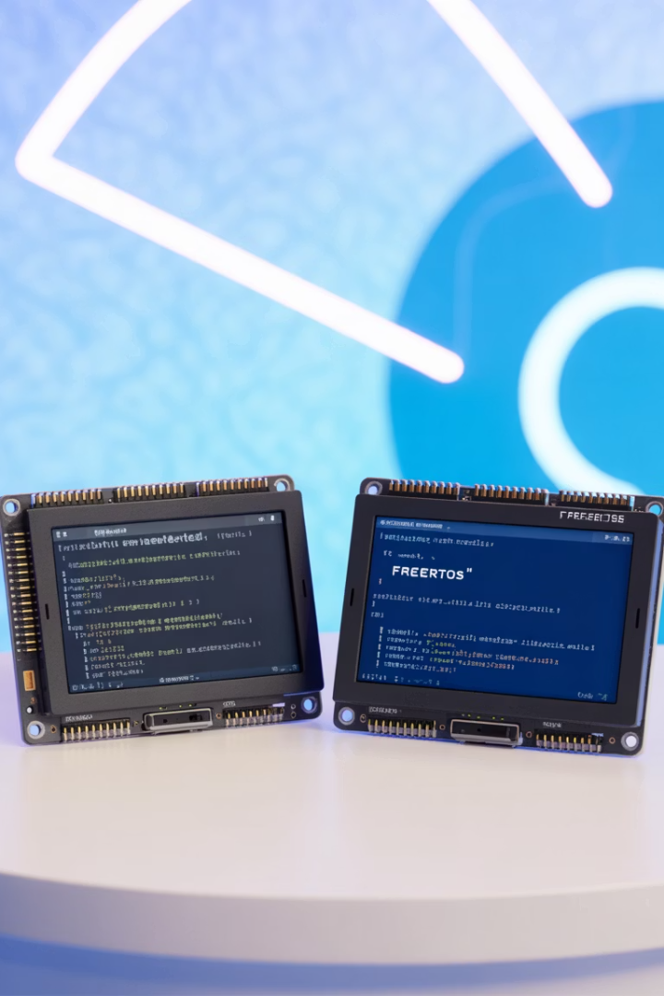
Advantages over Alternatives
Feature
Zephyr RTOS
Linux
Bare Metal
Memory
KBs
MBs
Minimal
Boot Time
Milliseconds
Seconds
Immediate
Determinism
High
Low
Manual
Portability
High
Medium
None
Power
Efficient
Hungry
Variable

Slide 8



Real-World Products Using Zephyr
Consumer
Galaxy Ring, Moto Watch 100
Computing
Chromebook EC, Framework Laptop
Industrial
Vestas, BLiXT, IoT devices
25+ Million Devices in the Field

Slide 9





Getting Started
Setup
Install deps, setup west, get SDK
Develop
Clone repo, choose sample, target board
Deploy
Build/flash/debug with west
Learn More
Docs, GitHub, Discord
Notes:
show zephyr repo + documentation. support boards and subsystems

